Slide 1
Robot manufactures
Stefan, Sven & Thijs

Slide 2
What are we going to talk about?
6-axis robot arm
3D model
Manufacturing
Stepper motors

Slide 3
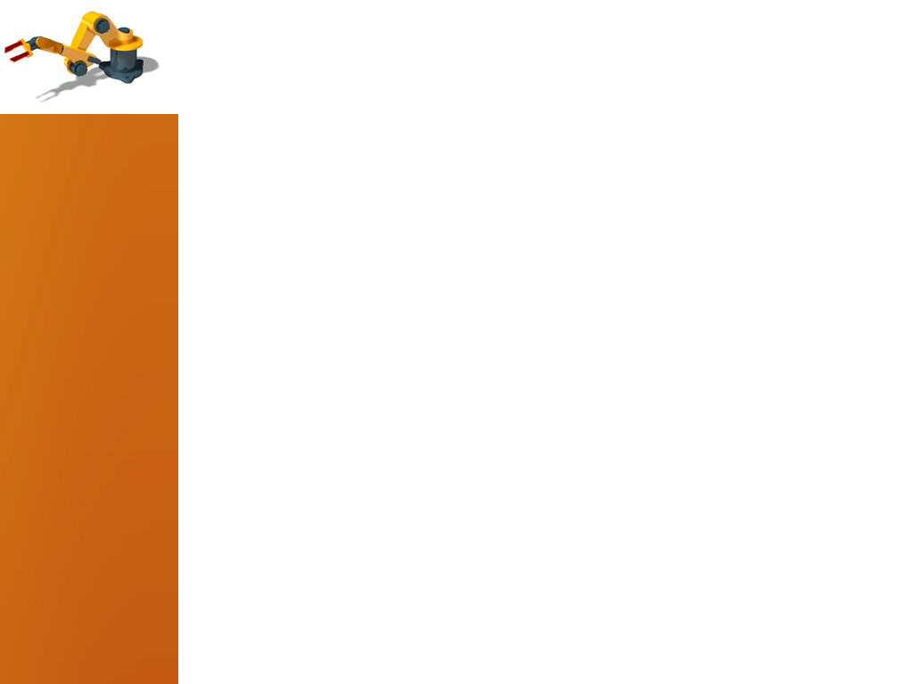
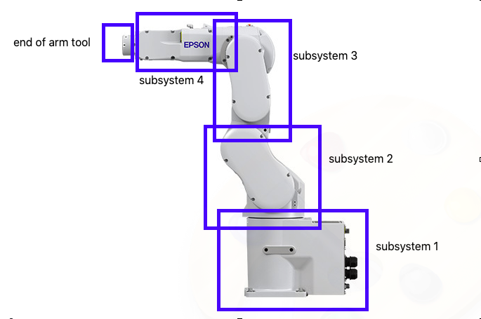

6-axis robot arm
Goal: make a pick and place system for a minimum weight of $±500 gram$.

Slide 4
3D-model
Design in Inventor
Aluminum parts
3D filament parts

Slide 5
manufacturing
3D printing
Waterjet cutting

Slide 6
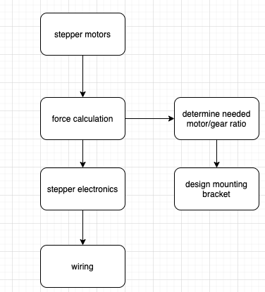
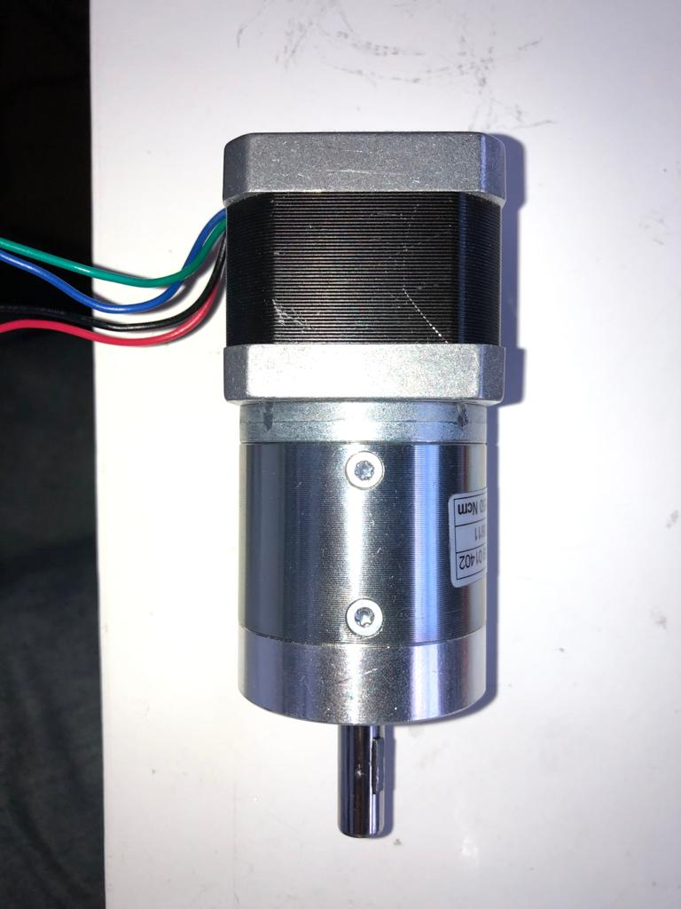
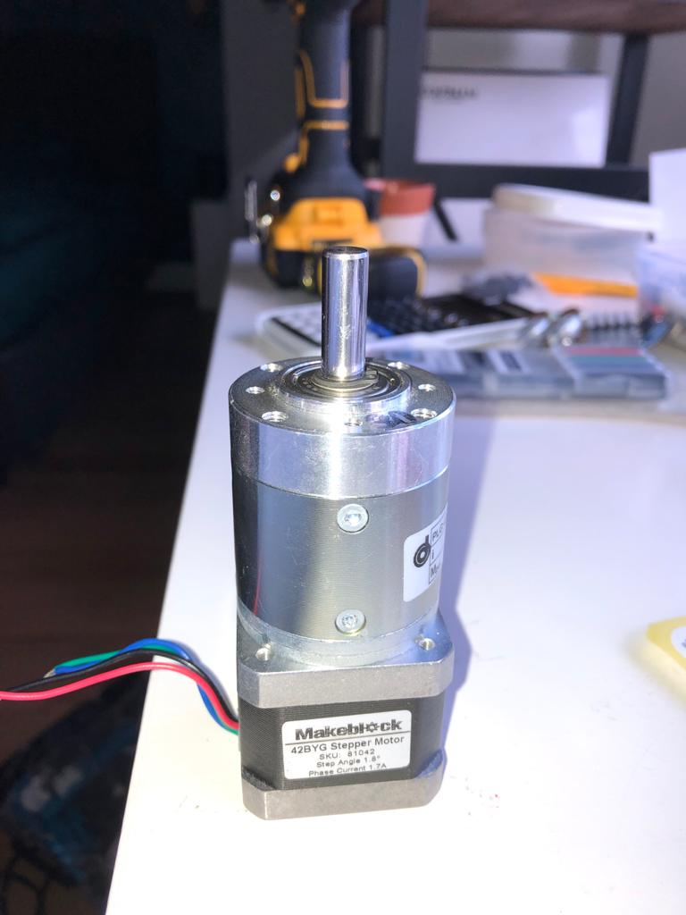
Stepper motors

Slide 7
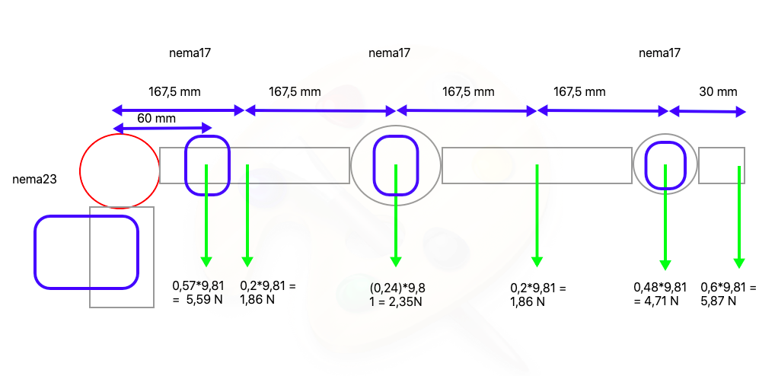
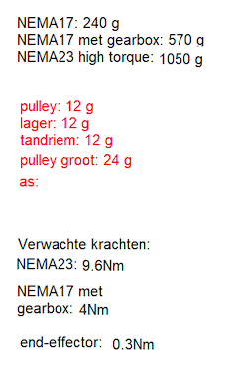
Stepper motors

Slide 8
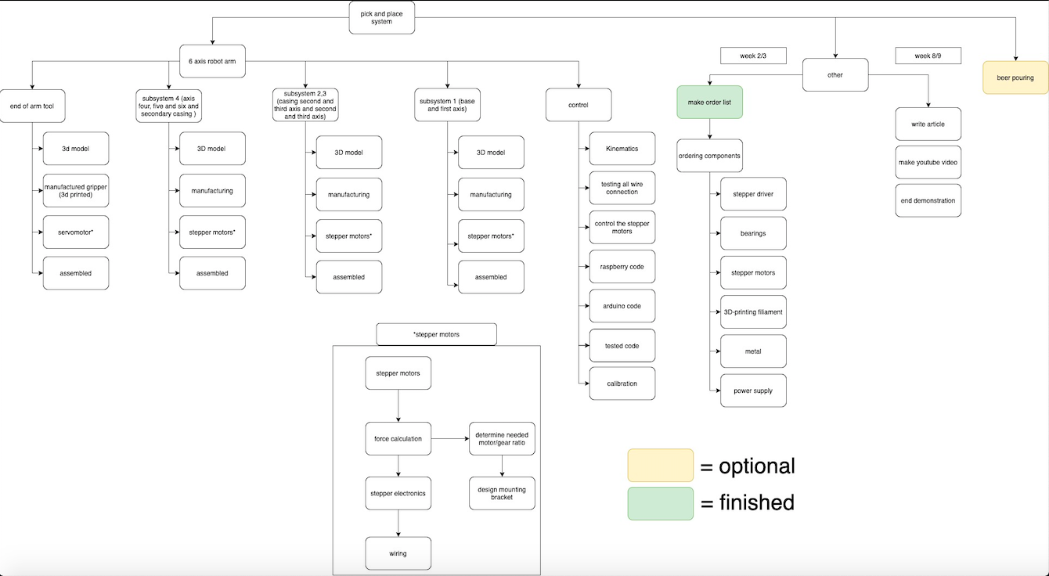
Planning next week

Slide 9
Questions

